Slide 1
Detecting Drowsiness
Name: Jinshan Yang, Hengrui Wang, Uttam Kannantha, Weiqian Zhang

Slide 2
Problem Statement
Detecting the drowsiness of a person by processing the image of the eye/eyes and face.

Slide 3
Motivation
Drowsiness is one of the common reasons for road accidents, especially among truck or bus drivers who drive for long hours.
Self-driving/autonomous vehicles make this scenario worse as they reduce the active involvement of drivers in driving.

Slide 4
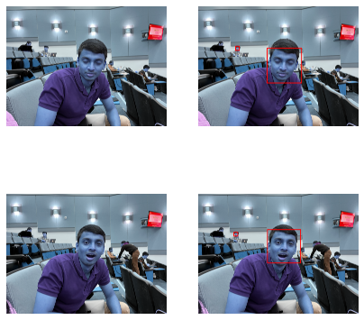
Solution
Face detection from the image taken in car environment.
We used Densenet 201 to
Train Eye open/close
Train Yawning from images

Slide 5
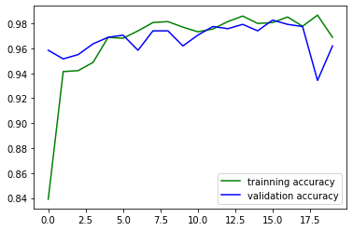
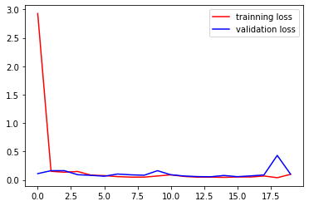
Results
Successfully detected face, Yawning and Eyes close/open
Current accuracy : ~94% on test set.

Slide 6
Social Impact
Direct impact:
Stop nearly 100,000 road accidents are related to Drowsy-driving which includes 50,000 Injuries.
Indirect impact:
Economic/Financial
Emotional

Slide 7
Feasibility and Scalability
Large data set in necessary to tackle wide range of facial feature
Needs special attention to detect facial features with mask and dim lights
Can expand the use case to cover detection person under DUI.

Slide 8
Future Work
Processing the live feed from the dashcam and prediction the driver’s condition in real time.
Utilizing Hardware and Software to use results and avoid casualties

Slide 9
Thank you!

